Slide 1
IPL Case study
Submitted By : Abhishek das

Slide 2
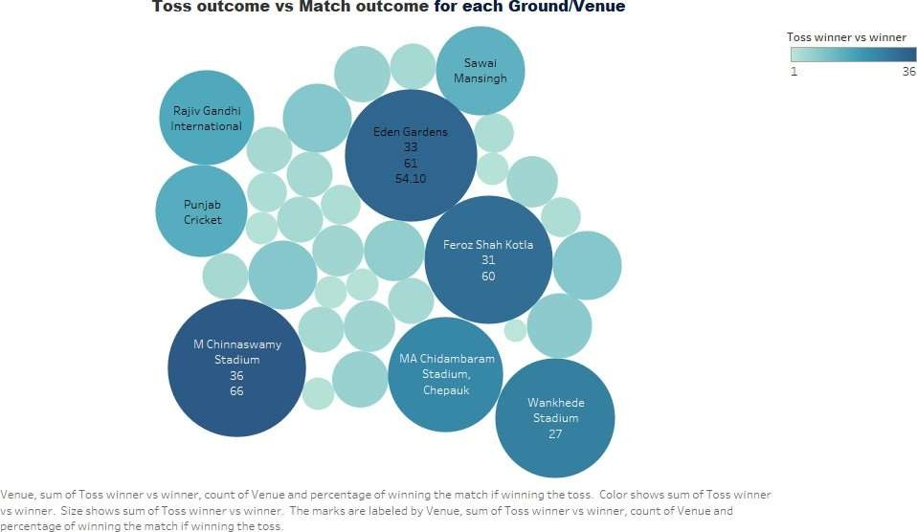
Here, M Chinnaswamy stadium shows highest chance of winning the match If team wins the toss

Slide 3
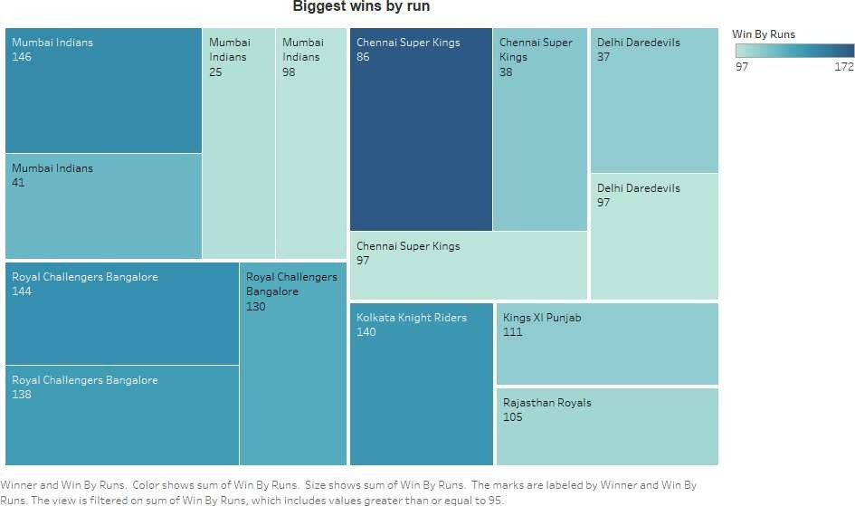
Mumbai Indians is the team , who has biggest win by run i.e. 146

Slide 4
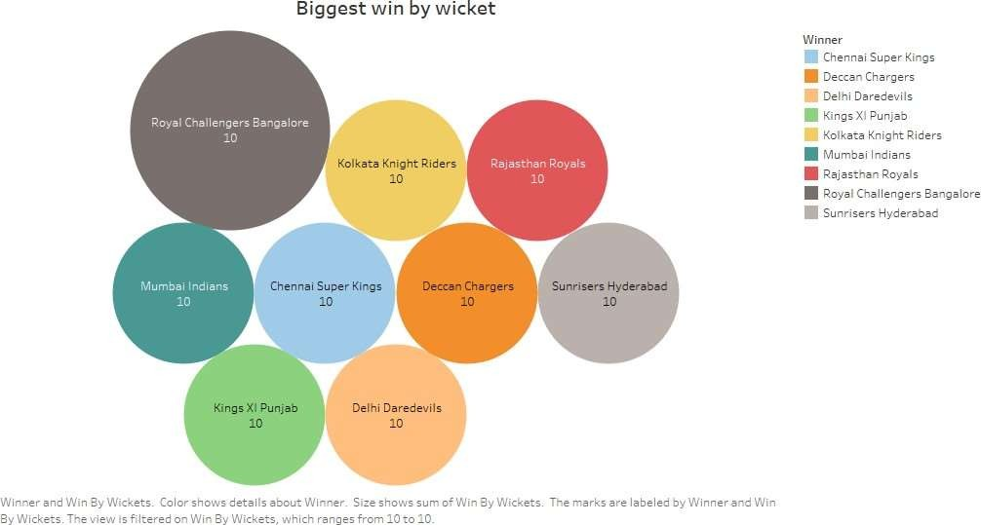
Royal Challengers Bangalore has won most number of time by 10 wickets.

Slide 5
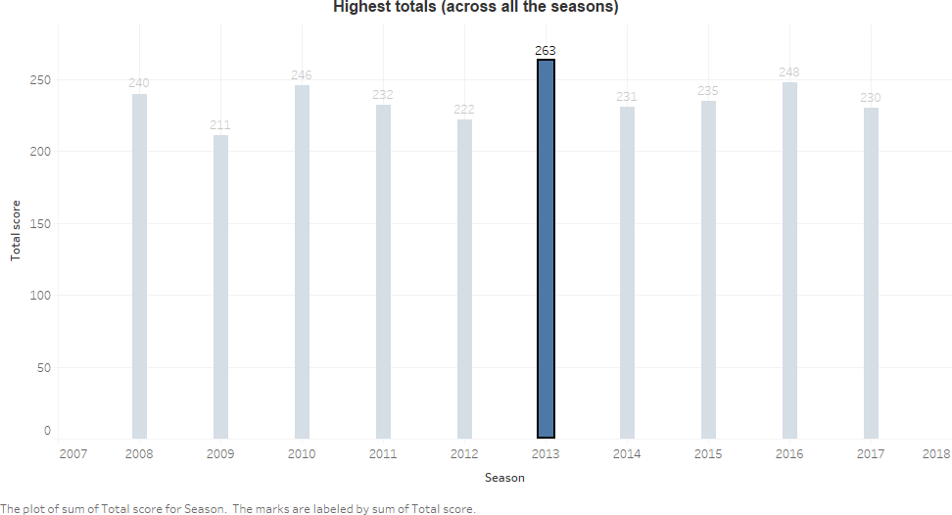
The highest total across the all the season is 263 in season 2013

Slide 6
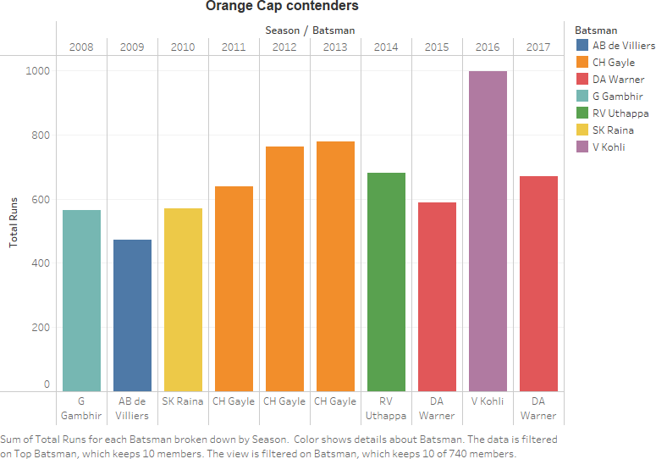
Charts represent the orange cap contenders each season

Slide 7
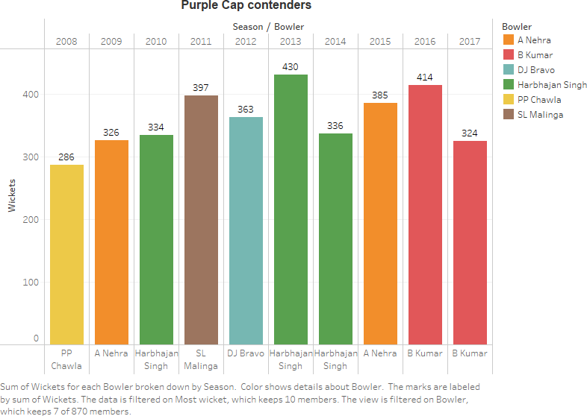
Chart represents purple cap contender in each season

Slide 8
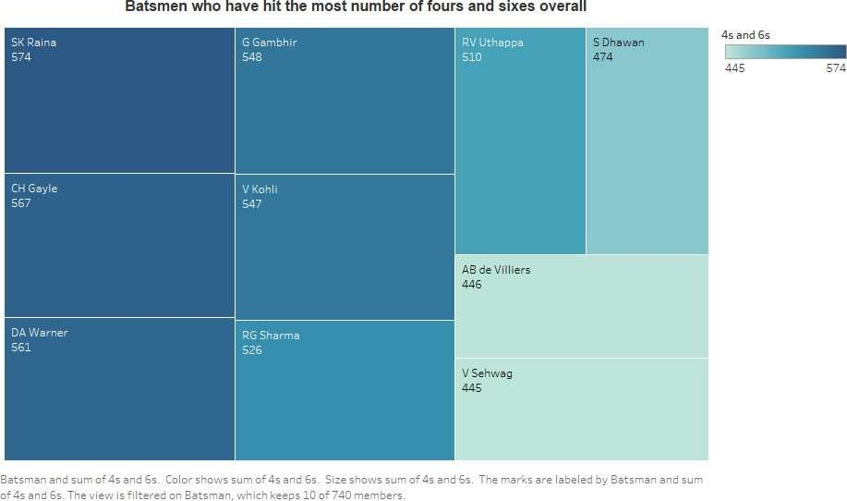
Here, SK Raina has scores most number of fours and sixs overall.

Slide 9
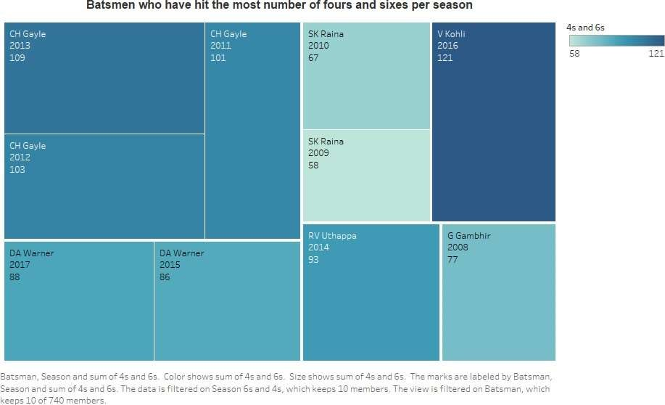
Here , we could see the batsman who has score most number of fours and sixs per season

Slide 10
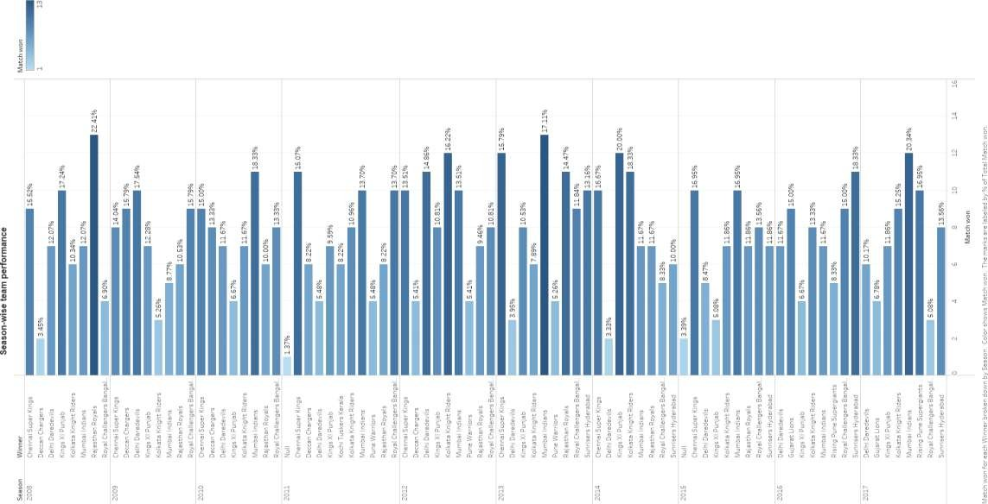
This bar graphs shows performance of each time per season

Slide 11
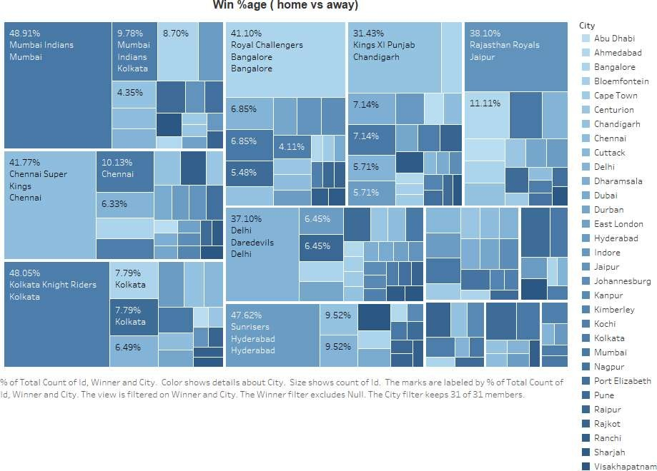
Here we could see that Mumbai Indians has highest percentage of winning the match in their home ground

Slide 12
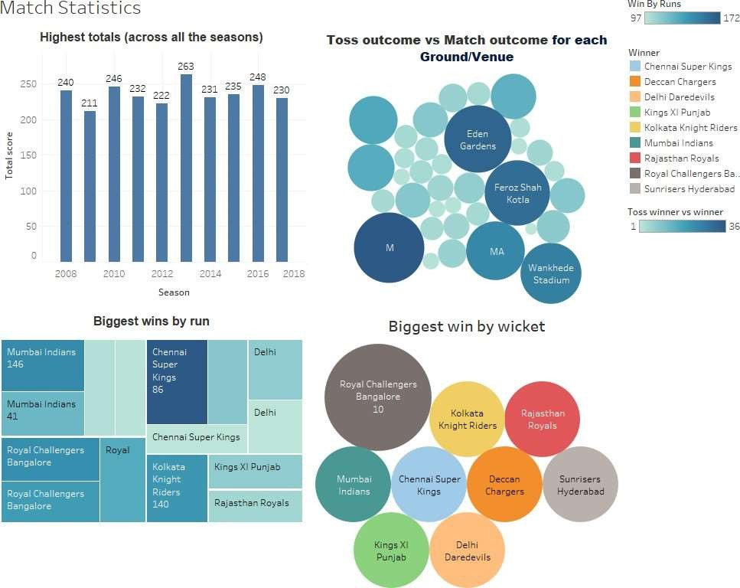

Slide 13
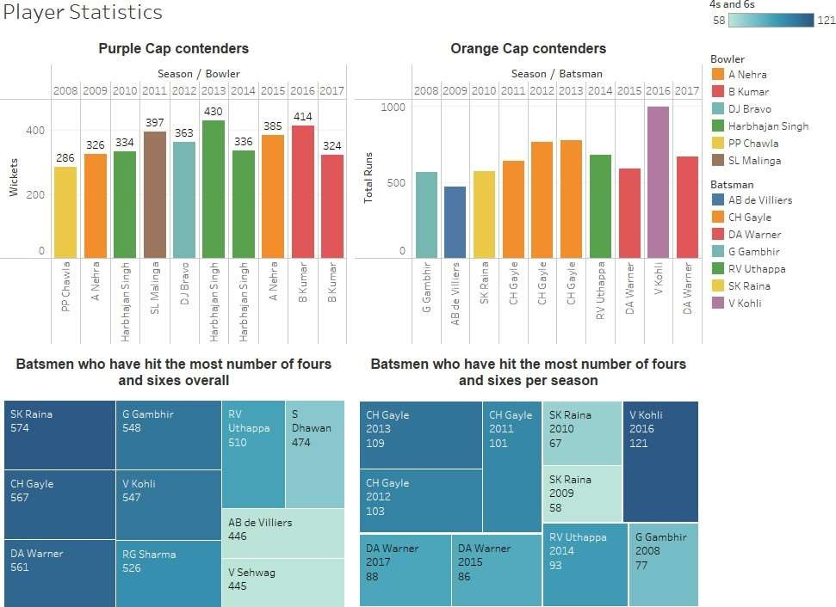

Slide 14
